Slide 1
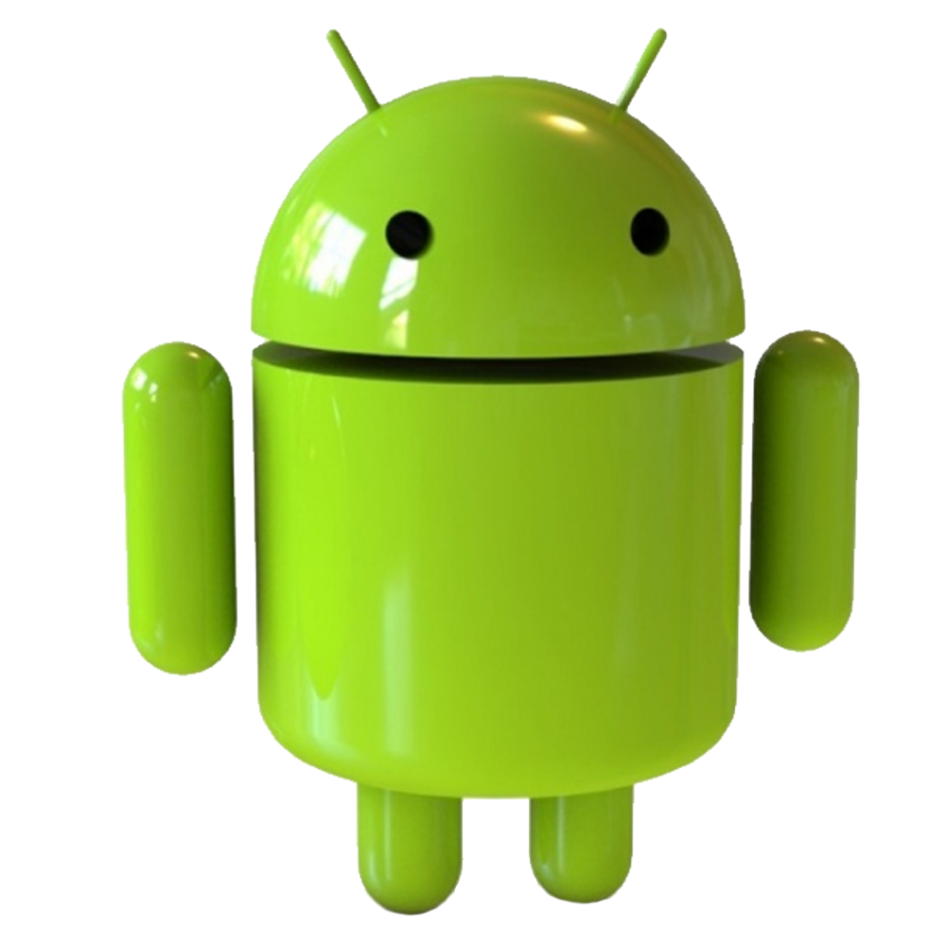
Presentation on
Android Operating System

Slide 2
What is ?
Android (stylized as android) is an “Open Source” Mobile Operating System (OS) developed by Google primarily for touchscreen mobile devices such as smartphones and tablets.
Android has been the best selling OS on tablets since 2013 and on smartphones it is dominant by any metric due to its user friendly interface.
Variants of Android are also used on notebooks, game consoles, digital cameras, and other electronics.

Slide 3
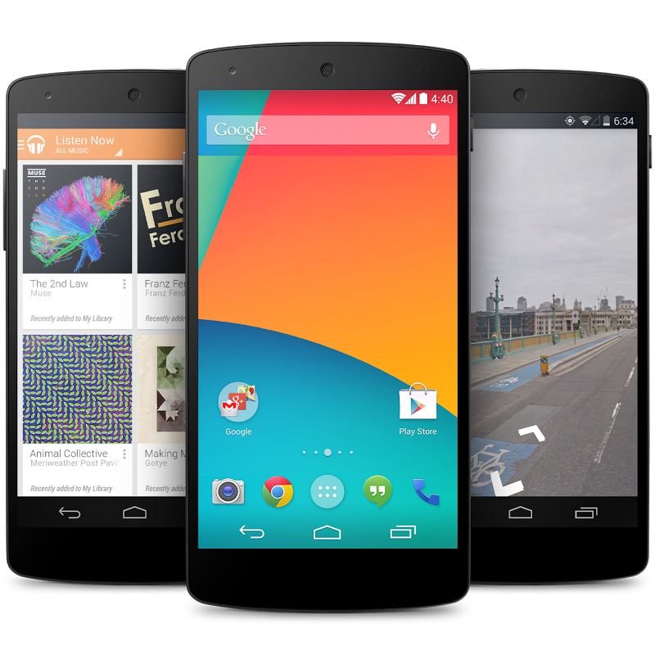
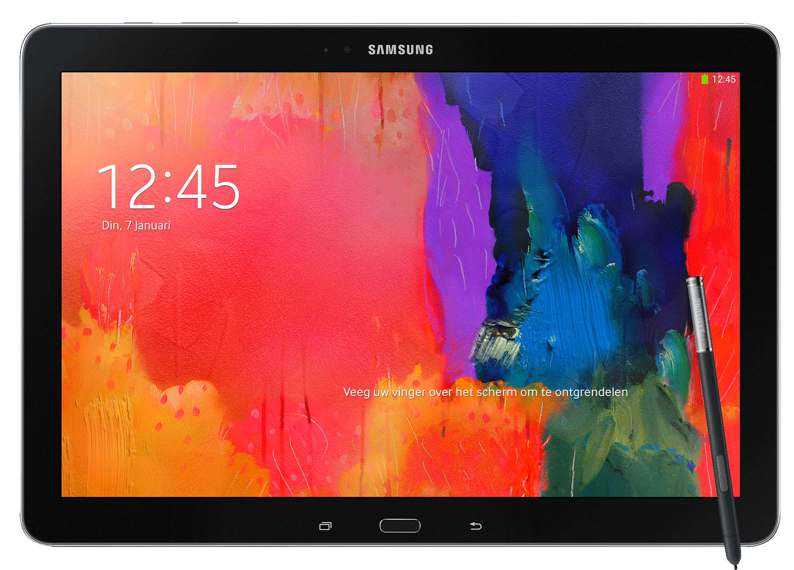
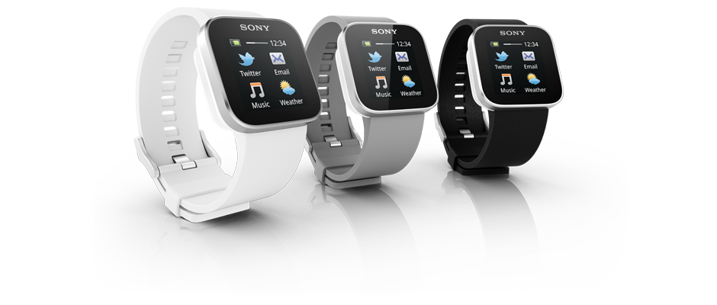
Devices use
Smartphone
Tablet
Smart watch

Slide 4
A Bit of History………...
2003
Android, Inc. found in Palo alto in California, United States by Andy Rubin
2005
Google acquired Android Inc.
2007
Google unveiled Android SDK for smartphones in November.

Slide 5
Versions of
1.0
Cupcake
1
Donut
1.5
Eclair
4.0.4
Icecream Sandwich
4.3.1
Jellybean
4.4.4
Kitkat
1.6
Froyo
2.1
Gingerbread
2.2.3
Honeycomb
5.0.1
Lollipop
6.0
Marshmallow
Nougat
7.0

Slide 6
Features
Android can run multiple apps at the same time (Multi-tasking)
Also support optimized graphics VGA, 2D graphics and 3D graphics.
Android has a better app market.
Android lets you change your settings faster
It gives you more options to fit your budget. (Economical)
Android is much more user friendly and heavily customizable in comparison to other smartphones.
Android also support Java applications.

Slide 7
……Continued
Hardware Features
Cellular Networking : GSM, EDGE, 3G
LAN : Bluetooth and Wi-Fi
Graphics Hardware Acceleration
Camera, GPS and Compass
Touch screen and Accelerometer for motion sensing
Software Features
Integrated browser based on the open source Web Kit engine
SQLite for relational data storage.
Media support for common audio, video, and still image formats.

Slide 8
Software Architechture
Application
Application Framework
Linux Kernel
Android Libraries
Android Runtime

Slide 9
Application Development Process
Setting up Development Environment
Coding
Building and Running
Debugging
Testing
Releasing apps in Play Store

Slide 10
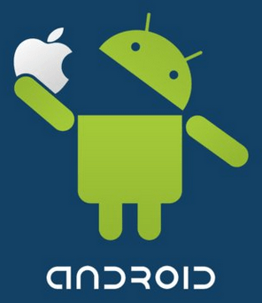

Slide 11
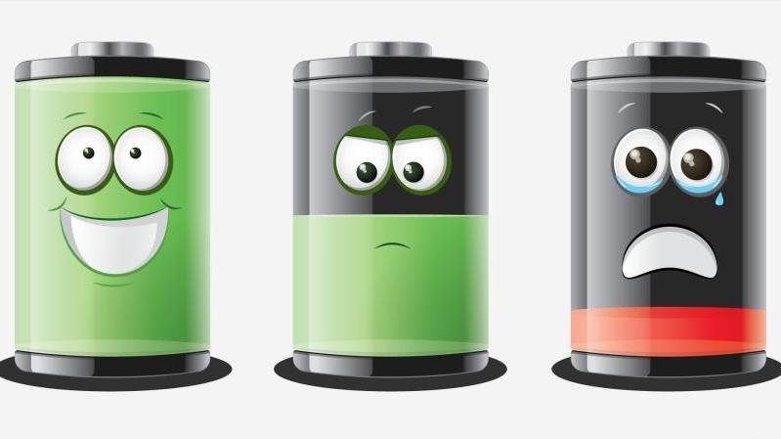
Limitations
Android Mobiles consume a lot of battery power.
Android is world of applications. So, we continuously need to be connected with the internet which is not possible for all the users.
Highly Vulnerable to Malware, Spyware and Virus.

